Slide 1
Iowa FCCLA Peer Education
Janet Mann
Peer Education Team Coordinator

Slide 2
What is FCCLA Peer Education?
Peer Education is a concept developed by National FCCLA to develop programs/projects which are delivered to their membership and members’ communities via their members – hence the term peer education.

Slide 3
Benefits for Members 6-12
Peer education is a great place for members to start.
Members have the opportunity to identify a concern in their community or school.
Pick one of the peer education teams, set goals, plan projects, carry their projects out, submit their projects to state staff and State Executive Council for review.
Receive recognition for the work they have accomplished.

Slide 4
Integrating FCCLA National Programs into your curriculum
Families First
Financial Fitness
Career Connections
FACTS
Community Service
Power of One
Stand UP
Student Body
Public Relations (Iowa)

Slide 5
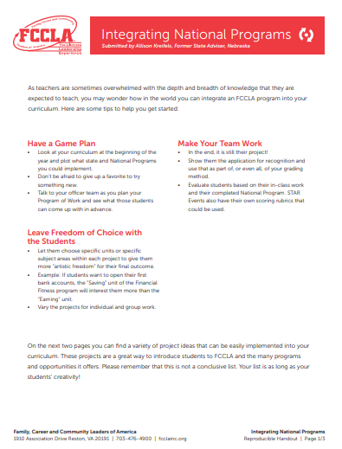
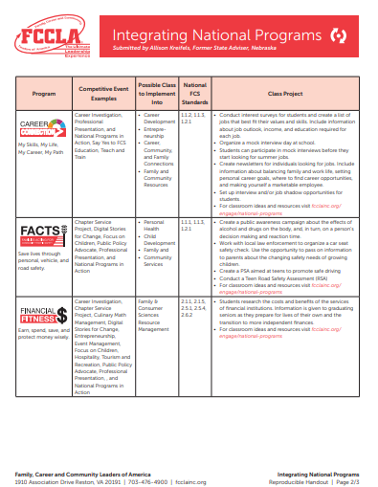
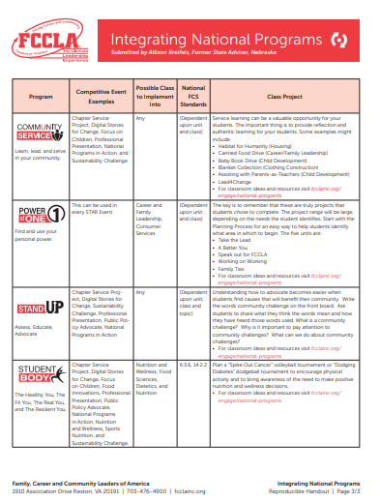
Integrating National Programs Handout

Slide 6
Iowa Peer Education/National Programs
Affiliated members pick a National Program based on the projects they would like to complete.
Members may work together on a team (1-5 members)
Register on the state website https://iowafccla.org/peer-education
Cost per member is $10.00
Deadline for registration is November 1, 2023

Slide 7
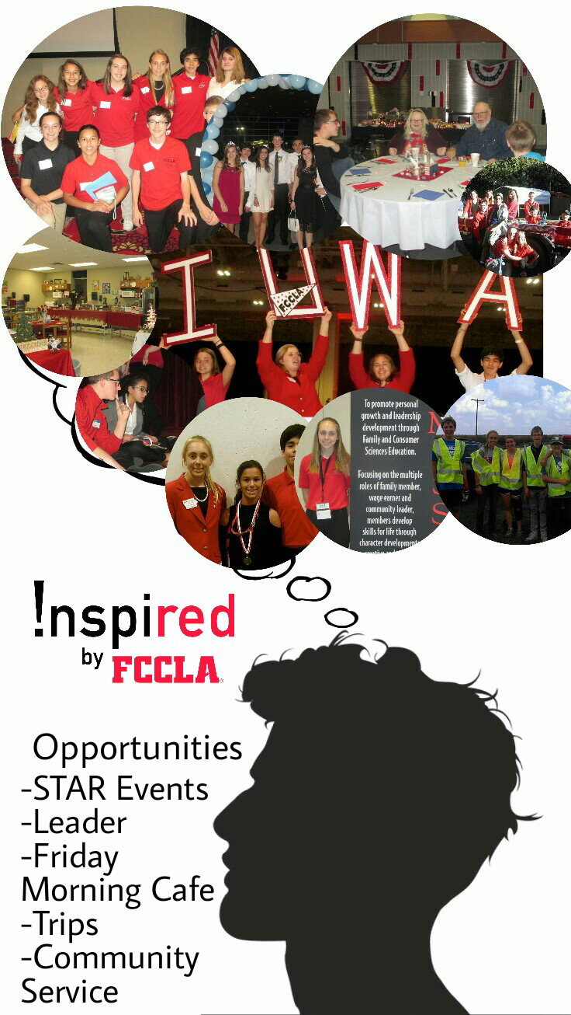
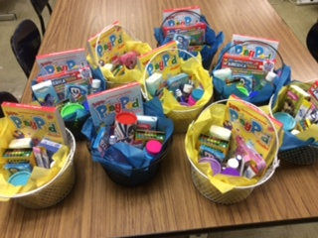
Two Formats for Project Success
Three Smaller Projects
One LARGE Project
Or

Slide 8
Format 1 - Three Smaller Projects
Completing three smaller projects based on the National Program, with one of the projects being from the required list.
Example: Members register for FACTS (Families Acting for Community Traffic Safety)
They complete their first project – Their project is to have Law Enforcement come speak to the student body about Distracted Drivers. (Required Project)
Members complete the Project Report Form on https://iowafccla.org/peer-education
Due dates are: Friday, December 8,2023, Friday, January 19, 2024, Friday, February 23, 2024

Slide 9
Format #2 - One LARGE Project
Members complete ONE LARGE extensive project (based on the National Program they have registered for)
Due Dates
Friday, December 8, 2023 Explanation of what your project is about and the time frame you will be following to complete.
Friday, January 19, 2024 Details of what you have accomplished and what you have to complete for the project
Friday, February 23, 2024 Completion of project, Proof of National Project Submission (Make a copy or screen shot of the project submitted to Nationals)

Slide 10
Large Project Examples
Plan an event that includes a large part of your community or school.
Examples: Veterans Day Program being held at school, contact all veterans in the community with a invitation to the program, provide a meal for those veterans, assist the Legion with the program, write an article for the newspaper about member involvement with Veterans Day.
Example: Baskets for Children’s Hospital - Members hosted four different fundraisers (bake sales) they had chapter members and faculty help with providing the baked goods. Money raised was used to purchase items for older children in the hospital. Bake sales were held during September-November. Chapter members helped to decide what to purchase for the children, members delivered the baskets to Omaha Children’s Hospital.
Although members think doing One project might be fast and easy, the planning and carrying out the project will require just as much work as three smaller projects.

Slide 11
Methods to Present Projects
Posters
Flyers – Bathroom Talk
Daily announcements
Newspaper articles
Video’s
TV Slide Shows
Presentation – FCS Class, FCCLA meeting, District Meeting, 4-H Meeting, Youth Group, School Board, Middle School/Elementary,
Host a table with information – At a school concert, open house, home ball games
Volunteer
Anything that educates your peers, provides a service, and builds your leadership skills
Turn your project into a STAR Event

Slide 12
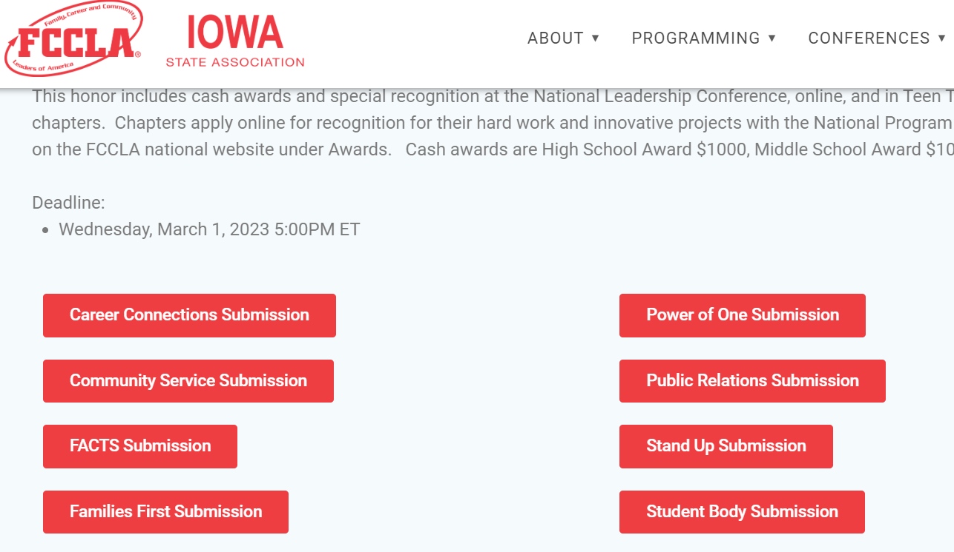
Project Report Form
On Iowa FCCLA Website https://iowafccla.org/peer-education
Located at the
bottom of the page (Red Tabs)

Slide 13
Report Form Questions
FCCLA Chapter Name ( West Monona FCCLA)
Adviser’s Name
Adviser’s Email
List the names of the members on the team
Email addresses of the members
Project Format (Guest speaker, Poster, Newspaper article, assembly…)
Project Due Date (this is a check box for the project due date)
Project Title
Project Information – Paragraph (Who, What, When, Where, and Why)
How many people in the audience 300 (Very important for state reports)
Checkbox Adviser certifies that the information being submitted is correct
***There is a section on the report form for the LARGE Project Report

Slide 14
FCCLA State Officers
Career Connection - Madison Stille – VP of Competitive Events
Community Service – Macy Thorson – VP of Community Service
Families First – Brody Kuhse – First Vice President
FACTS – Emma Jensen – VP of Parliamentary Law
Financial Fitness – Emersyn Rentschler – VP of Finance
Power of One – Chloe Klarenbeek – VP of Development
Stand Up – Julia Eastman – VP of National Programs
Student Body – Autumn Jones Popp – VP of Membership
Public Relations – Cerra Muntz – VP of Public Relations
***Required Projects – designed by State Officers

Slide 15
Awards
Members who have completed the project requirements (One Large Project and National Project submission OR Three smaller projects) by the required due dates.
Will Receive…
Each member of the team will receive an Award of Excellence and team pin
Recognition at State Leadership Conference
Members who complete at least one project and submit a project report form will receive a certificate of completion.

Slide 16
National Program Award Applications
Members completing the LARGE Project for Peer Education must provide proof of the Program Award Application before March 1, 2024.
This can be found in the FCCLA Portal under the tab – Program Awards
Be sure to print a copy of your application and send a copy to Janet Mann

Slide 17
FCCLA Peer Education History
1985 – 2023 Iowa has had 4,013 Members participate in Peer Education
In 2014 Members impacted 31,785 Peers with their projects.
In 2023 Members impacted 114,814 Peers with their projects.
NEW as of 2022
In 2022 $400 ($100 per school) was awarded in Scholarships to Peer Education members schools.
In 2023 $800 ($100 per school) was awarded in Scholarships to Peer Education members schools.

Slide 18
State Officers will now explain the suggested projects

Slide 19
Career Connections – Madison Stille VP of Competitive Events
My Skills-
Take an interest inventory, Career Quiz and pick a career that you’re interested in, then find an opportunity to job shadow that career. When finished share the interest inventory and job shadow with fellow peers.
Arrange for business owners to volunteer to host Career Job Shadows to provide opportunities for students.
Create a poster about a job you feel passionate about. The poster should contain information about work experience, skills, education, professional licenses, accreditation and certification, specific knowledge, personal traits and attributes, languages, and physical ability.

Slide 20
My Life Research and Create a poster on ways to balance life’s work stress and life’s complications. Create a poster/pamphlet from your experiences from the job shadow opportunities. My Career Bring in someone to instruct students how to write a resume and cover letter. Host a Career Fair for students to gain insight on a wide variety of careers. Visit a Children’s Hospital or invite someone to speak about all of the different careers within a Children’s Hospital.

Slide 21
My Path
Create a poster of how you and others can reach their career goals by following some basic steps listed on your poster.
Have Business Professionals come and teach students interview skills, they conduct mock interviews.

Slide 22
Community Service Macy Thorson VP of Community Service
Learn- Members explore personal values, ethics, and ethical decision-making while evaluating your community needs
Have a speaker come and talk about their cancer experience. It could be at a sporting event such as a basketball, football, volleyball, baseball or softball game.
Lead- Members learn how to use your leadership skills to serve your community and how to transfer those servant leadership skills to the workplace
Organize a drive for blankets, cool pillowcases, canned or packaged food items, or any other hospital needs.

Slide 23
Service- Members are introduced to the critical role community partnerships and advocacy play in serving the needs of others while also developing your own community-based service
Make and serve a meal at a Ronald McDonald house for the families staying at the house. Donate the items that you raised for the hospital.

Slide 24
Families First Brody Kuhse First Vice President
Dynamics – Understanding families and family relationships – What do Families facing cancer have to deal with?
Create a list of resources that can help families facing an illness/disease. Share this list through a presentation, newspaper article, poster. Interview some of the resources and share their methods of helping families.
Research 3 types of cancers that might affect people in your area and display them on posters around your school with the cancer ribbon colors included.

Slide 25
Balance- Enabling young people and families to prioritize self-care and overcome obstacles – How does a cancer diagnosis directly and indirectly affect families and the community?
Research medical professionals and social workers who work with families struggling with sickness.
Invite a guest speaker (Social worker, medical professional, non-profit chair) to present about what families facing diseases have to go through.
Development – Learning how to nurture and care for children – How can the community collaborate to support families dealing with illness or spread awareness about illness prevention?
Research the importance of routine medical checkups to detect illnesses before they progress.
Create a presentation, poster, or social media page displaying your research information about the routine medical checkups/test that detect illnesses. Share with your school and community.

Slide 26
Safety- Prioritizing and practicing safety within families – How can families facing cancer balance treatment and their careers? What are medical career paths for people interested in working with children?
Interview local health professionals or nonprofit organizations about pediatric care careers. Inquire what part of their professions is the most rewarding when working with children and families.
Create a presentation about what families fighting illnesses might be facing. Include local resources for support as stress management, and grieving techniques (classes offered by local hospital).
Skills – Developing strategies to be a good family member – What can the community do to nurture children and provide the best health possible?
Research and create posters for your school showing the importance of nutrition and healthy eating habits for children and teens.
Create infographics (based on research) for your chapter’s social media pages that help teach the community about the importance of regular medical checkups for children. (Examples include: Checkup frequency for infants, toddlers, teens and what they might include).

Slide 27
FACTS Emma Jensen VP of Parliamentary Law
Final Project Suggestions
People – Distracted Driver – Create a project, presentation, request a speaker, make a poster about distracted driving. Texting while driving, impaired/drunk driving. Make an impact by discussing the statistics of distracted drivers the laws and fines associated with this.
Vehicle – Seatbelts and Airbags – Create a project, presentation, request a speaker, make a poster about proper use of seatbelts and how they save lives. Include information about airbags and the danger of small children in the front seat.
Roads - “Follow the Rules of the Road” “Know your Signs” Create a project, presentation, request a speaker, make a poster about the rules of the road and knowing what the signs mean when driving.

Slide 28
Financial Fitness Emersyn Rentschler VP of Finance
Final Project Suggestions
Earning – Create a bulletin board of jobs that pay different amounts that teenagers could get. Include a description of the job, the amount you would make, and training needed to for the job. Include part-time and full time job opportunities in your area.
Spending – Research the similarities and differences how someone would spend their money if they didn’t have any hospital bills vs. families who have hospital bills. Create a project board/poster with all of your information and display it around school.

Slide 29
Saving – Create a poster that teaches others how to save extra money in case an emergency happens, such as medical bills. Create a chart to show how saving a small amount over a few months will prepare you for an emergency.
Protecting – Invite a speaker to teach about different types of accounts. Teach teens how to protect their money, debit cards, credit cards, digital banking, Apple Pay, Venmo, protecting your future by knowing about banking.

Slide 30
Power of One Chloe Klarenbeek VP of Development
Final Project Suggestions
A Better You: Make a vision board with all of your goals (large and small). Show the steps you plan on taking to accomplish them, and document your milestones to track your progress.
Family Ties: Ask your parents if anyone in your family has struggled with some type of cancer or a close family friend. Research the type of cancer they have/had and make a poster/presentation about it.
Working on Working: Research the different types of doctors that take care of cancer patients. Choose one that interest you, create a slideshow about it and present it for to your peers.

Slide 31
Take the Lead: Start a donation for items to make goody baskets for teenagers and children struggling from cancer in the hospital.
Speak Out for FCCLA: Go to the schools in your area that don’t have a FCCLA Chapter yet, make a presentation and educate them FCCLA and about this year’s theme “Walk in Their Shoes”. Share the theme within your school and encourage members and non-members to donate, educate, and become a member of FCCLA.

Slide 32
Stand Up Julia Eastman VP of National Programs
Final Project Suggestions
Assess: Create a Google form or blog discussing the NEEDS for the community. Send it out to the community and collect ideas and share in a newspaper article the needs expressed by the community.
Educate: Create a walk/run (5k) for every mile or so many steps walked you would get a bracelet/bead representing a color of a type of childhood cancer.
Advocate: Create a local “Closet” for young children in need. Allow the children to come and “shop” in the closet for items they need.

Slide 33
Student Body Autumn Jones Popp VP of Membership
Final Project Suggestions
The Healthy You – Host a “Walk for Childhood Cancer” in your school district at a local track or around your neighborhood to promote childhood cancer awareness.
The Resilient You – Create an article on the damage that childhood cancer does to families and how they try to combat those feelings.
The Real You – Make a poster emphasizing the importance of staying physically fit and eating healthy at a young age to help stay healthy.
The Fit You - Encourage your Peers and faculty to download a fitness app on your phone to track their steps and record them each week, set a goal and try to reach it each week. Chart everyone’s progress with teams working toward a healthy goal.

Slide 34
Public Relations Cerra Muntz VP of Public Relations
Project ideas specific to “Walk in Their Shoes” Children’s Cancer
Organize a walk to raise awareness and/or money for cancer treatment. After each mile, a participant can get a bracelet representing a different type of cancer.
Organize a CCA (Children’s Cancer Awareness) night. Raise awareness for children’s cancer. Invite a guest speaker for an assembly, class presentation, or sporting event to speak at halftime at a game. Ask for donations of money from local businesses to fund special shirts as warm ups for this special event.
Recruit FCCLA members and non-members to Sew colorful/fun patterned pillow cases in FCS classes and donate to Children’s Cancer Hospitals. Deliver the pillowcases to the hospital.

Slide 35
Make an information board to share in your school hallway about children’s cancer. Include types of cancer, cancer treatments, ways to help, anything else they can think of to put on this board for their school hallway.
Make an informational poster to share in your school hallways about children’s cancer. Include types of cancer, cancer treatments, ways to help, anything else they can think of to put on this board for their school hallway.
Make a slides presentation about children’s cancer and share it to your FCCLA Chapter, and FCS classes to raise awareness for children’s cancer. Include things like types of cancer, cancer treatments, ways to help, how your chapter is taking on this service project for this year.
Write a newspaper article to share in your school’s newsletter, community newspaper, school website.

Slide 36
Questions

